Slide 1
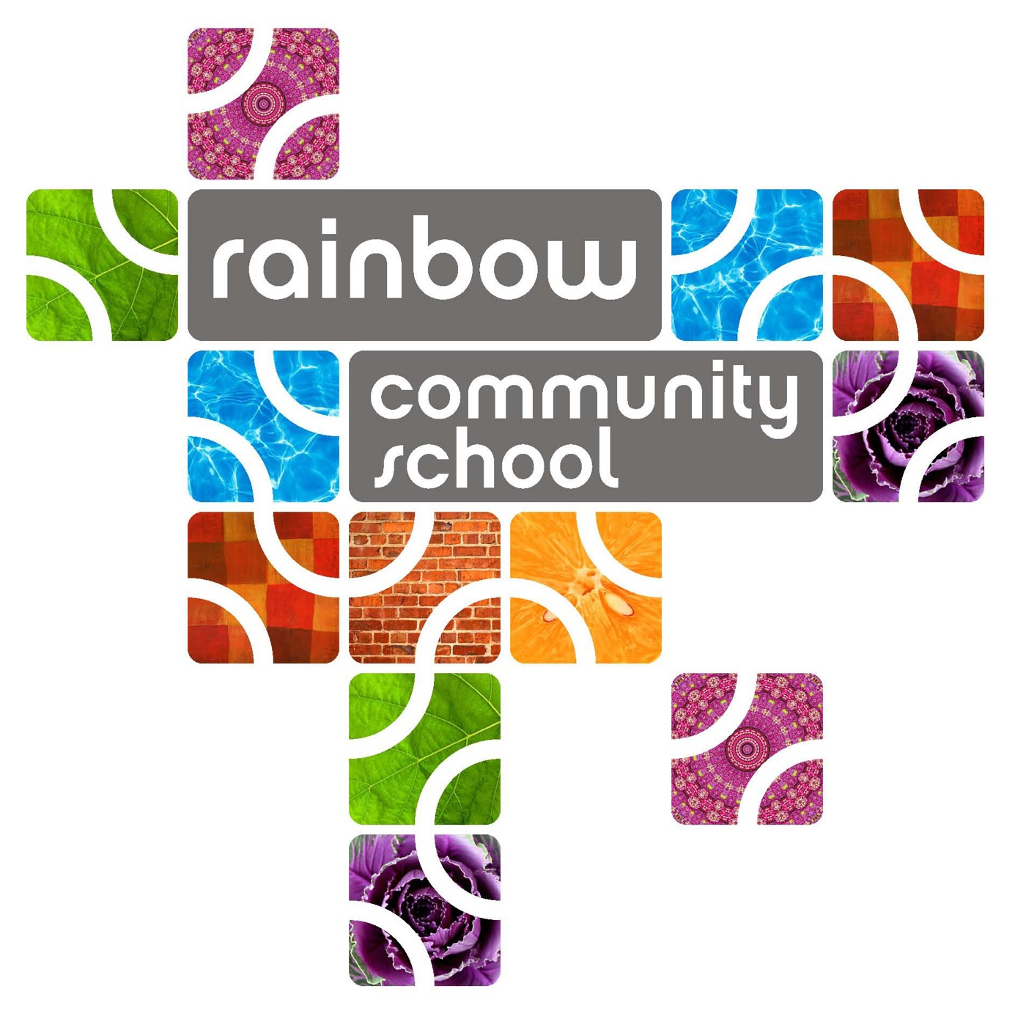
North Carolina Green Schools
2015-2016 Application

Slide 2

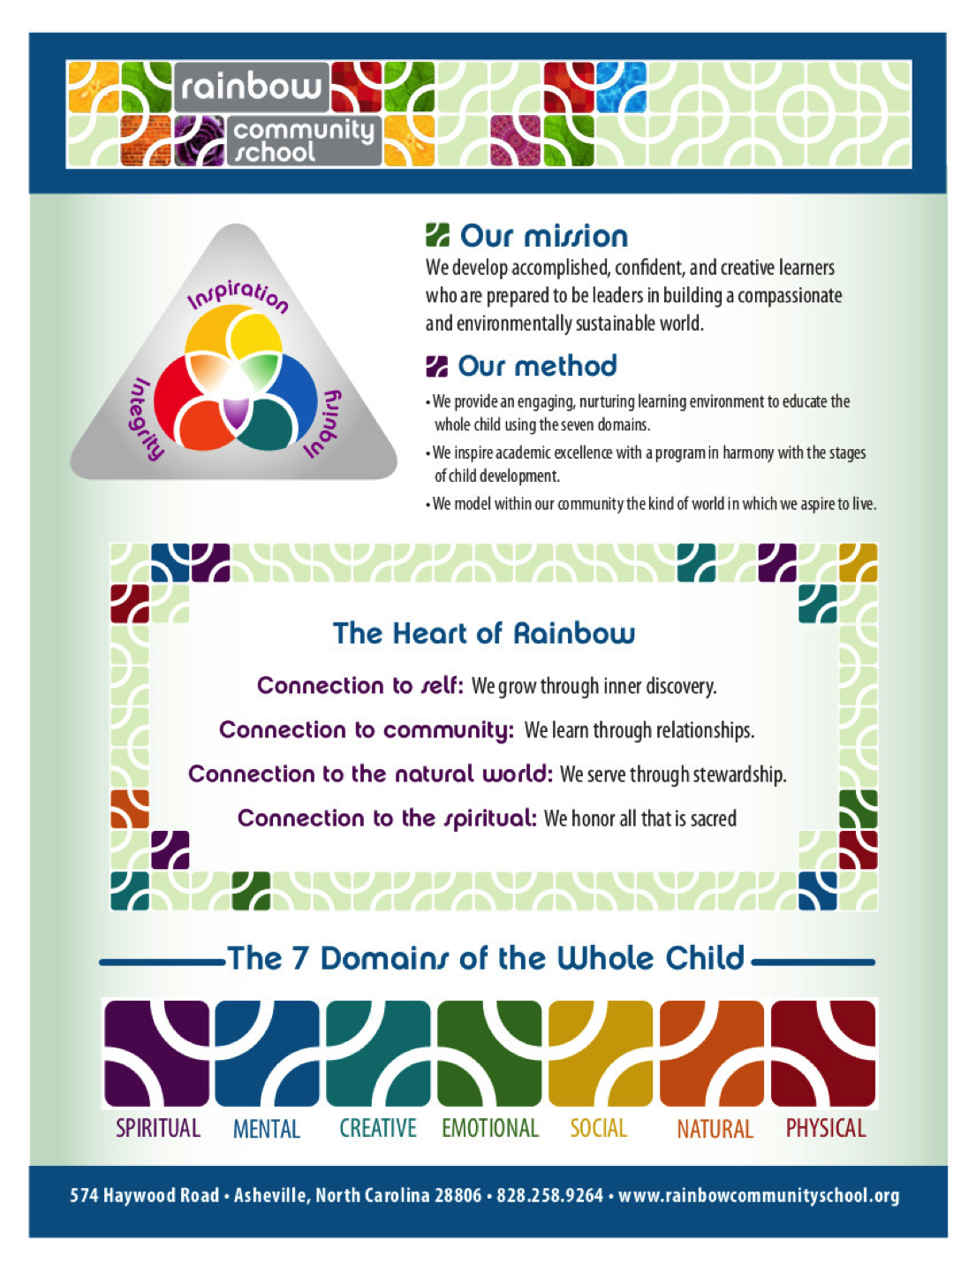
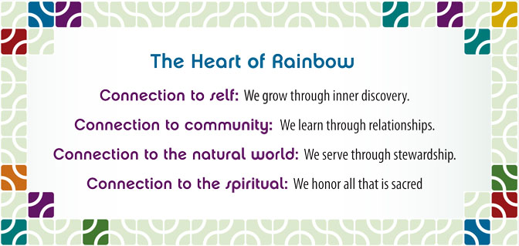
Our mission is to develop accomplished, confident and creative learners who are prepared to be leaders in building a compassionate and environmentally sustainable world.
Our method to provide an engaging, nurturing learning environment, to educate the whole child using the seven domains, to inspire academic excellence with a program in harmony with the stages of child development and to model within the community the kind of world in which we aspire to live.

Slide 3


Culture and Community
At RCS the student is viewed Holistically through Seven Domains: spiritual, mental, creative, emotional, social, natural, and physical.
The Natural Domain is expressed through time in nature, caring for the environment, gardening and animal husbandry, observation, inquiry and discovery.

Slide 4
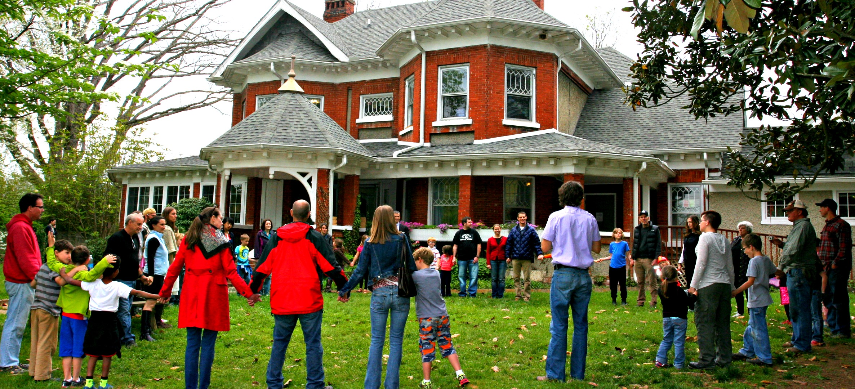
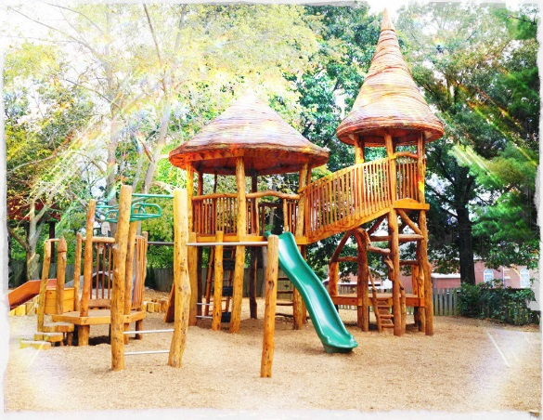
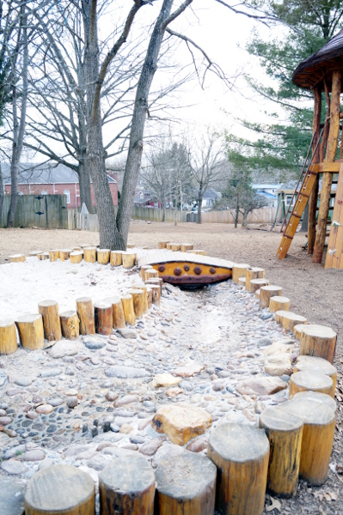
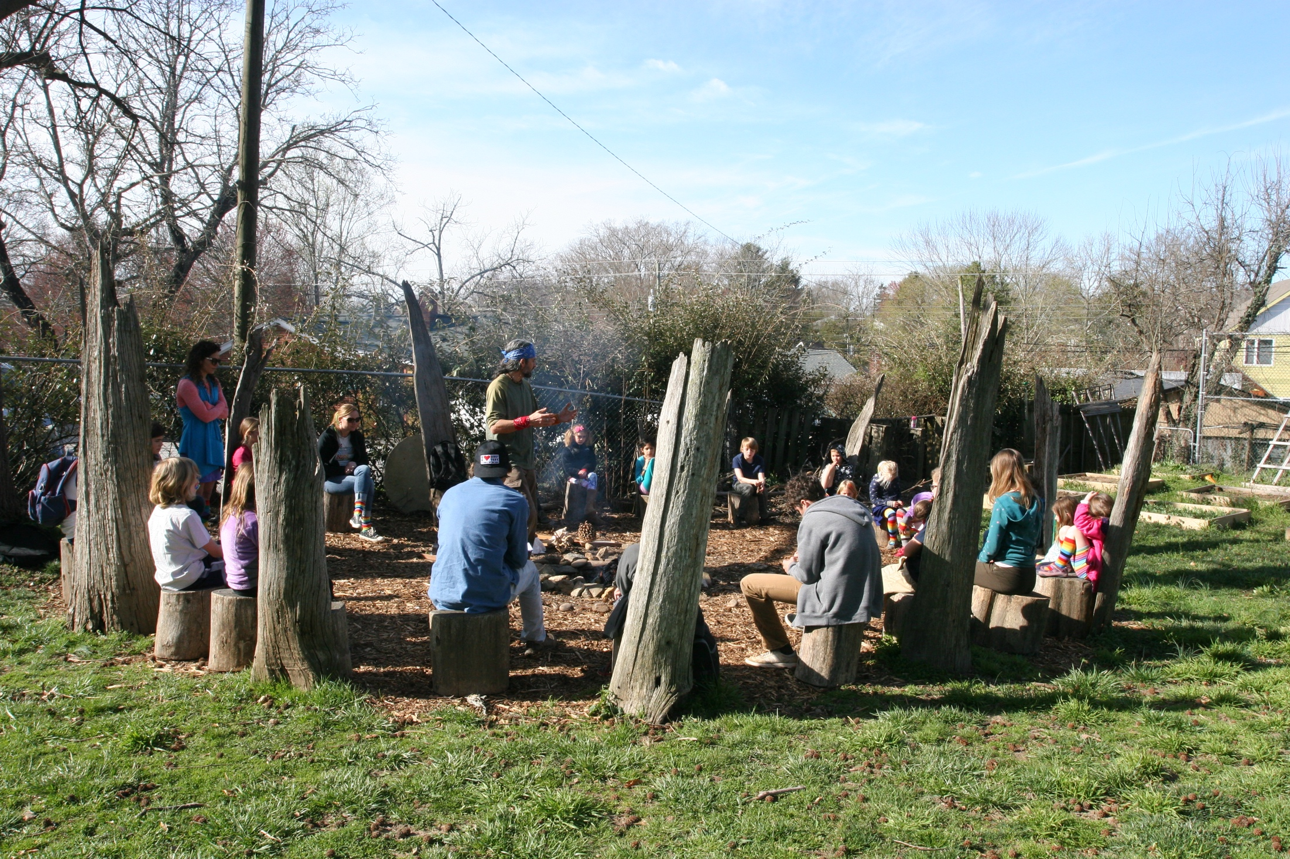
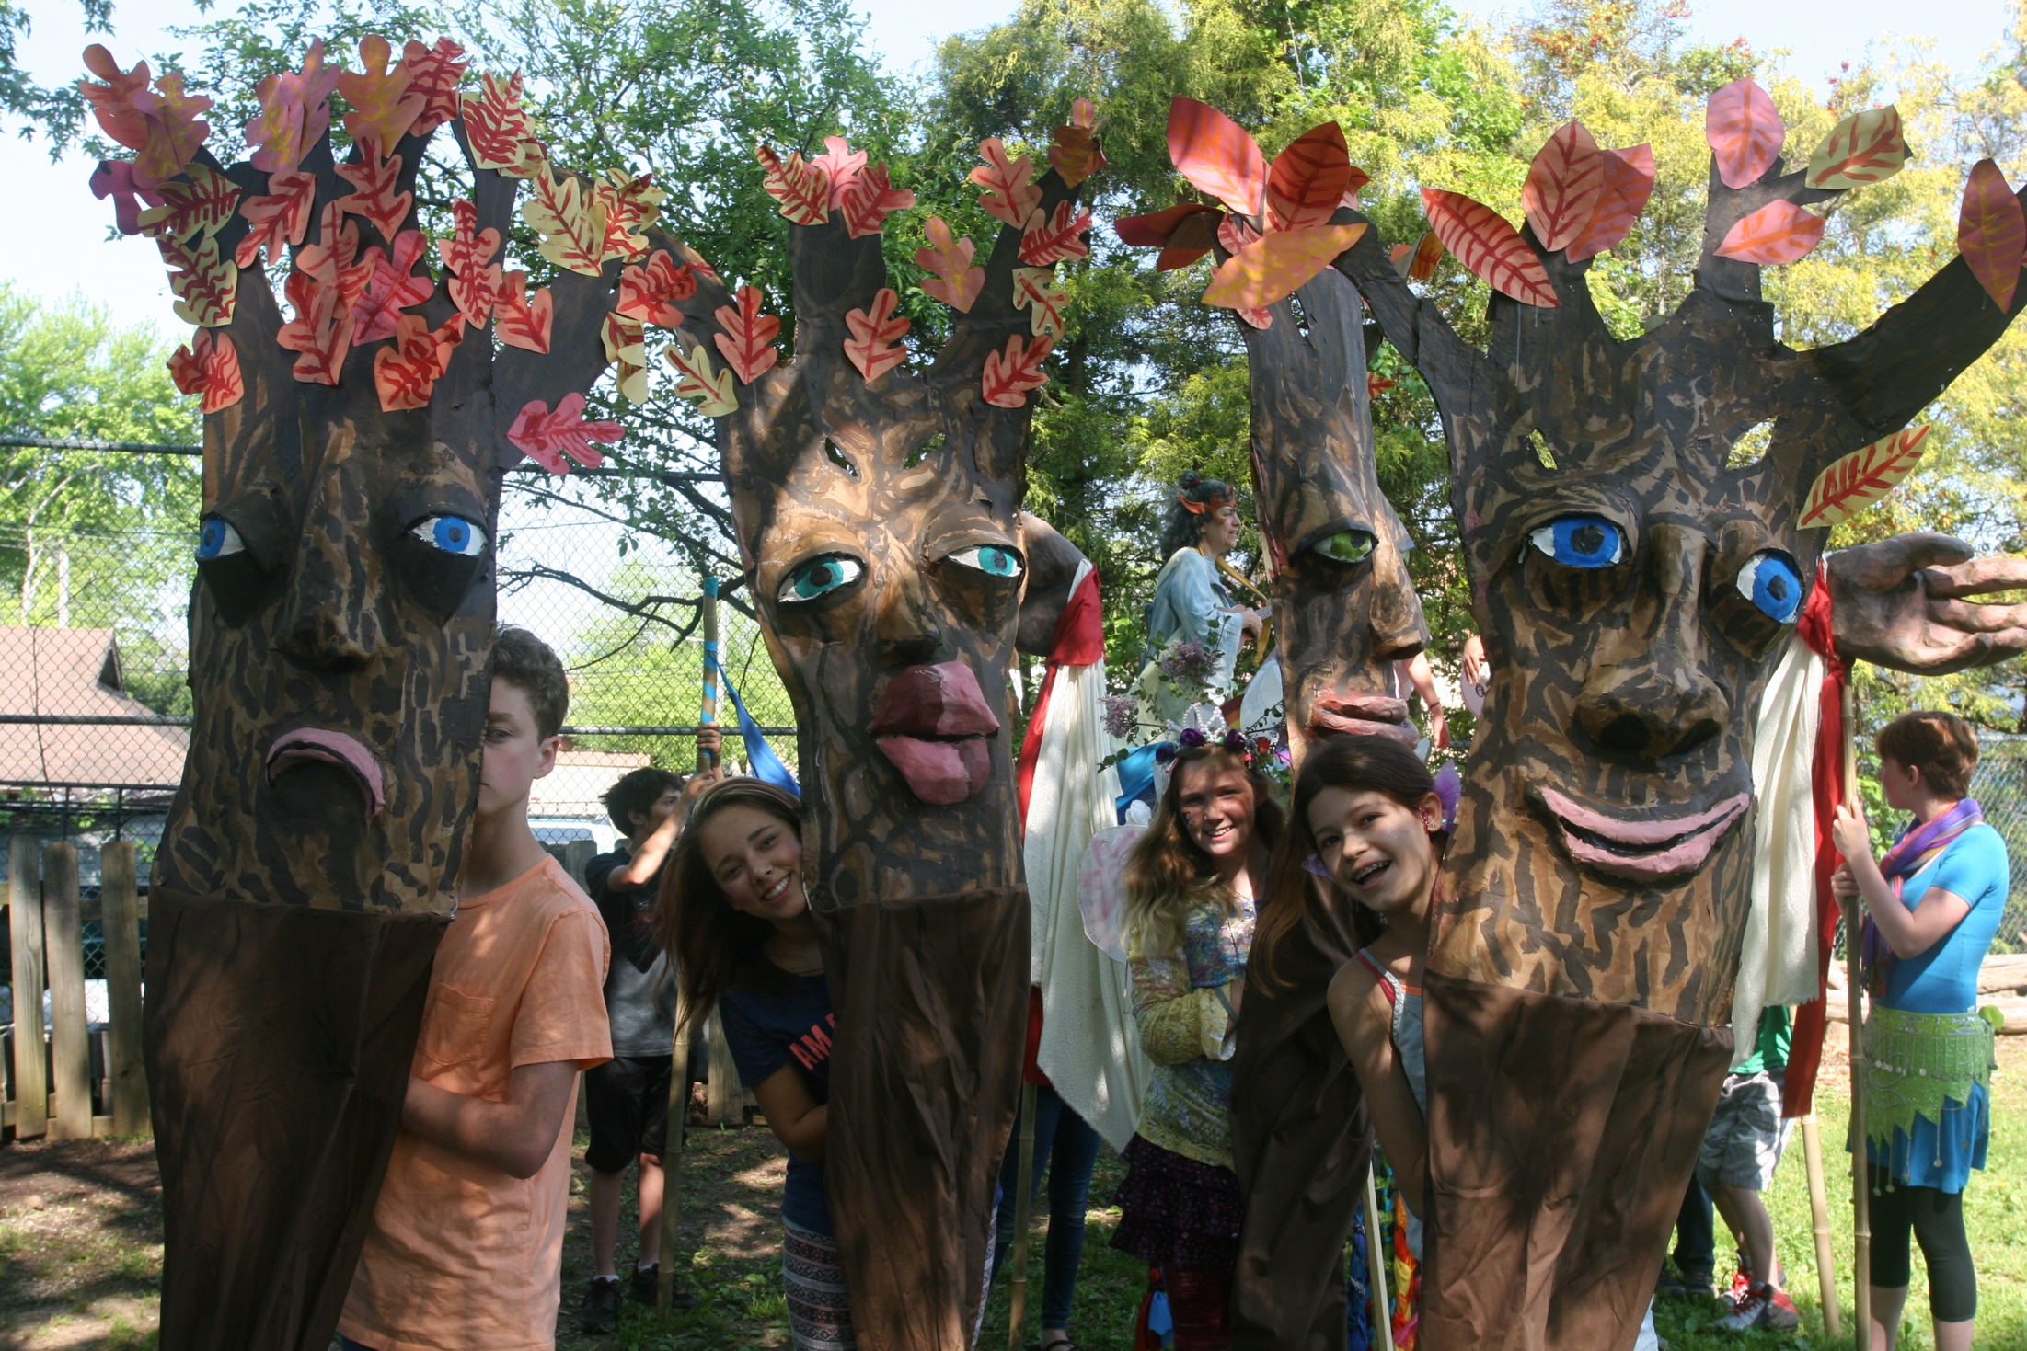
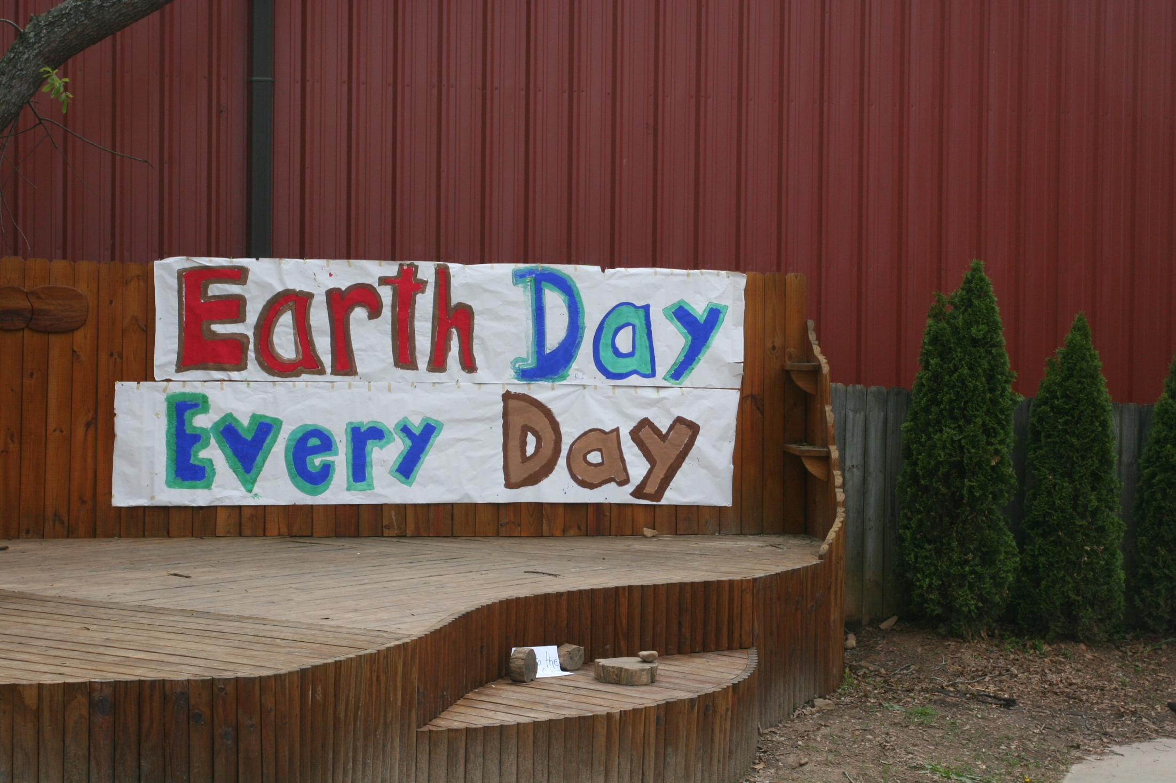
Healthy Schools
Rainbow Community School’s Commitment to Outdoor Learning
RCS is a 5 acre urban oasis. The campus maintains a natural setting in urban West Asheville.
The playground design encourages imaginative and interactive outdoor play.
Rainbow has an designated “outdoor classroom” but many areas on campus facilitate outdoor learning.
Seasonal celebrations and school wide gatherings are often held outdoors, such as Earth Day and May Day seen below.
Outdoor learning is an integral part of our yearly curricular scope and sequence as well as the every day schedule.

Slide 5
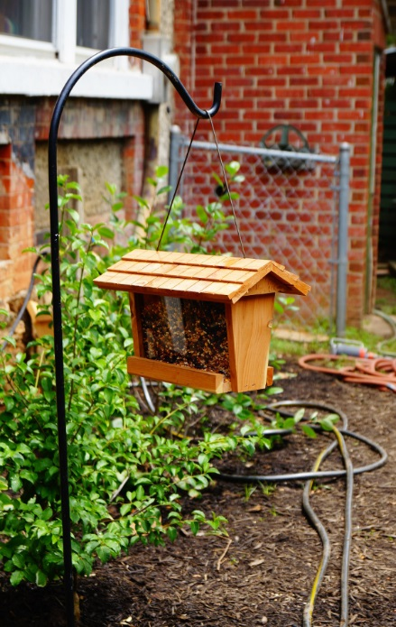
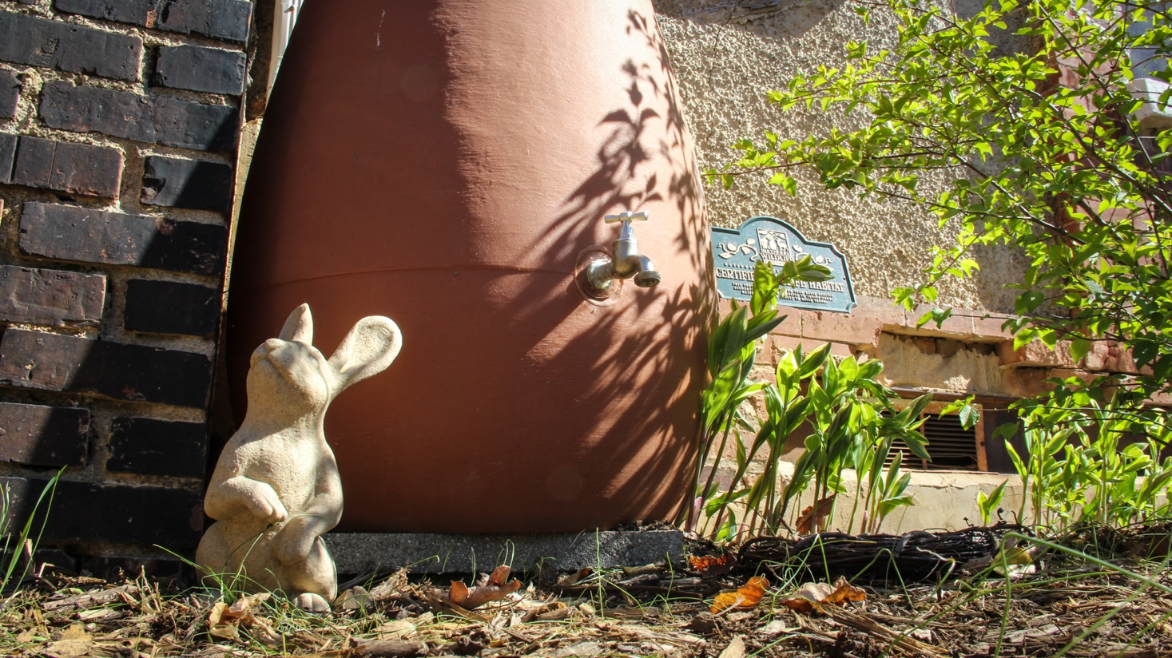

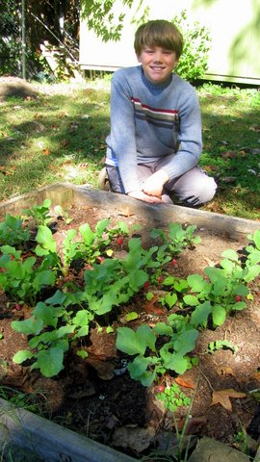
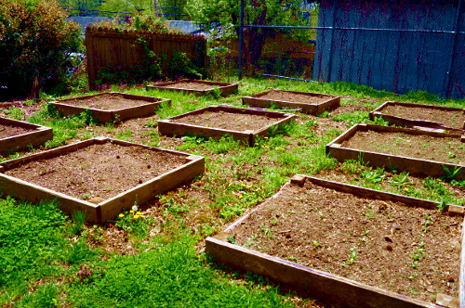
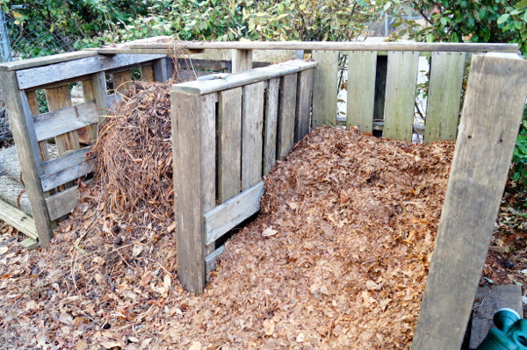
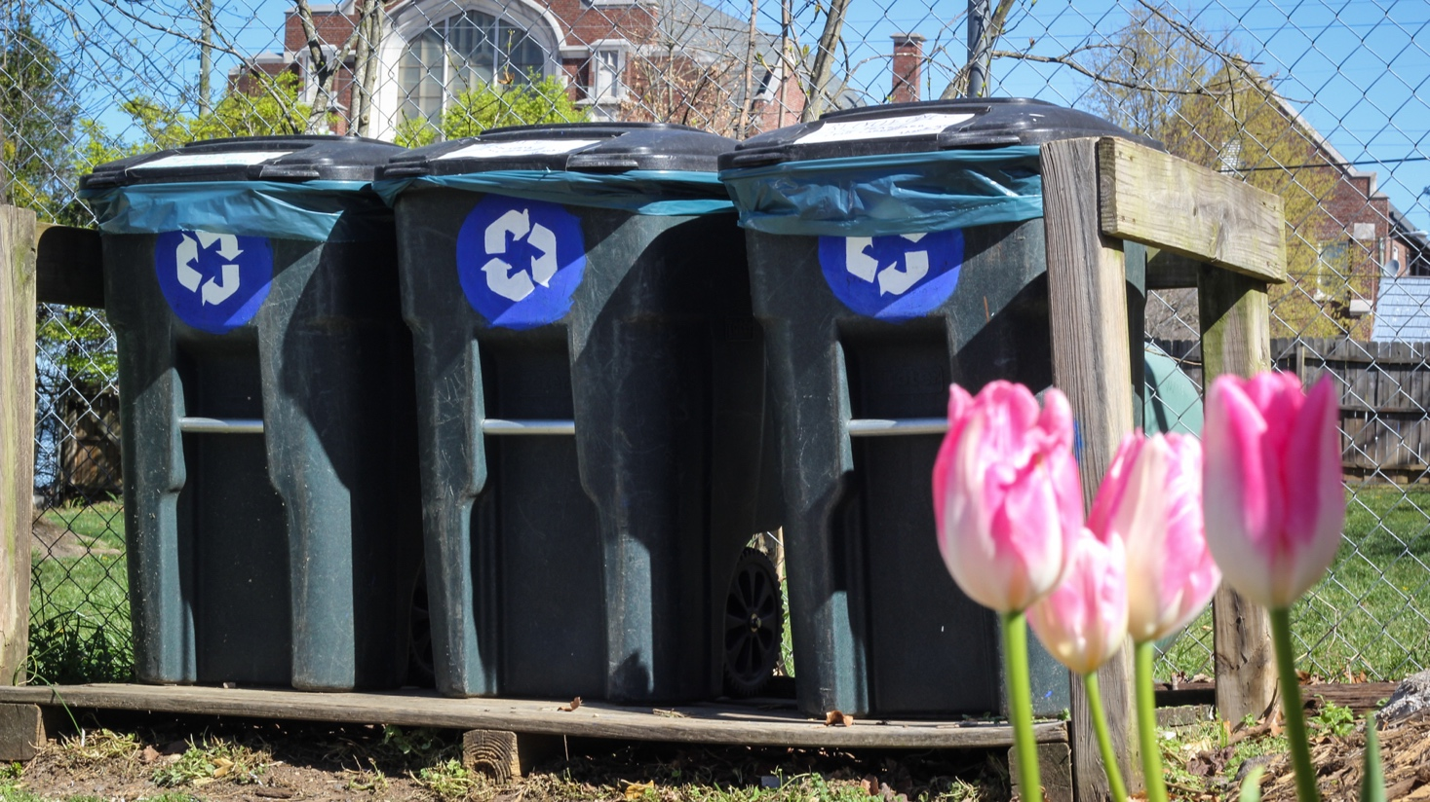
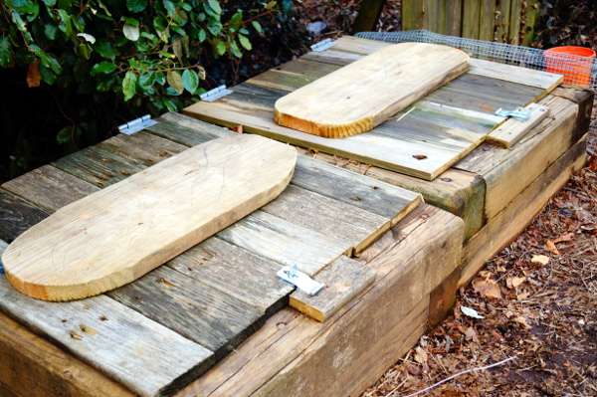
School Sustainability
Grounds and Facilities
Responsibly built and sustainably managed (passive solar, efficient fixtures and light bulbs, low flow toilets, reclaimed building products, native plant landscaping and invasive species control)
Outdoor “green” spaces include multiple gardens, composting, rainwater catchment systems, NWF certified habitats, water features, fire circles)
Playgrounds are built to mimic a forest
COMING SOON: Butterfly and Bird official Citizen Science Waystation
COMING SOON: Storm Water Management System in Collaboration with Buncombe County Soil And Water Conservation
COMING SOON: Perimeter nature trail system with informational plagues and kiosks

Slide 6
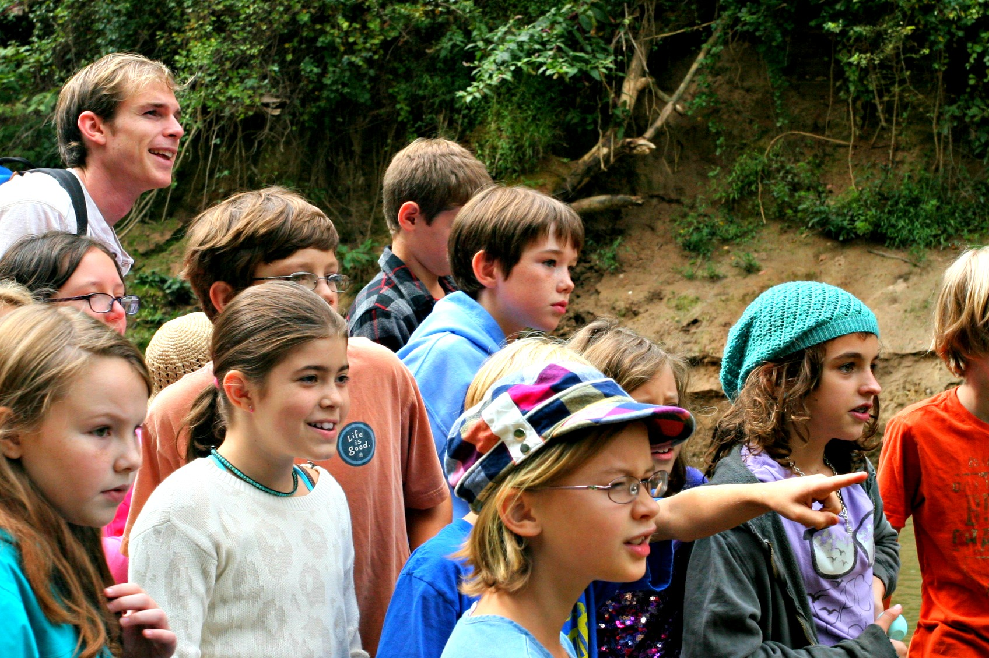
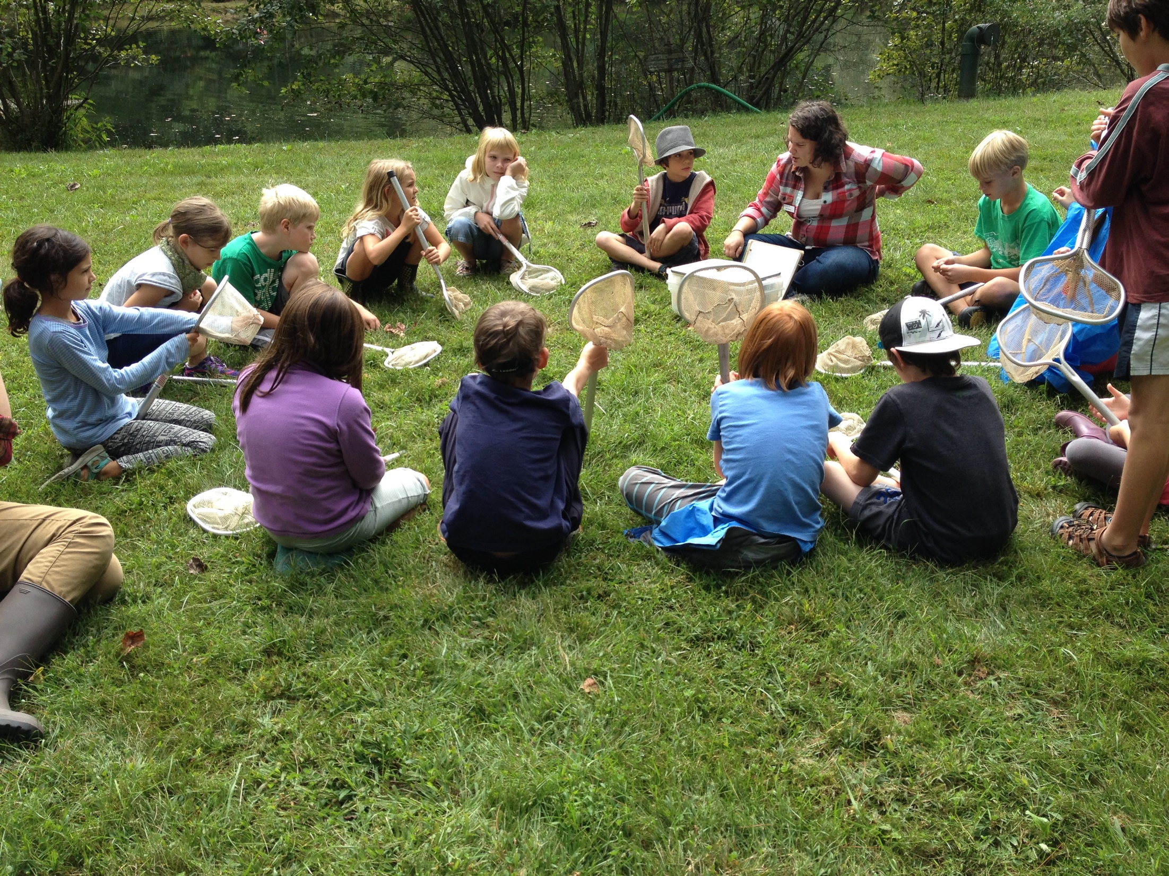
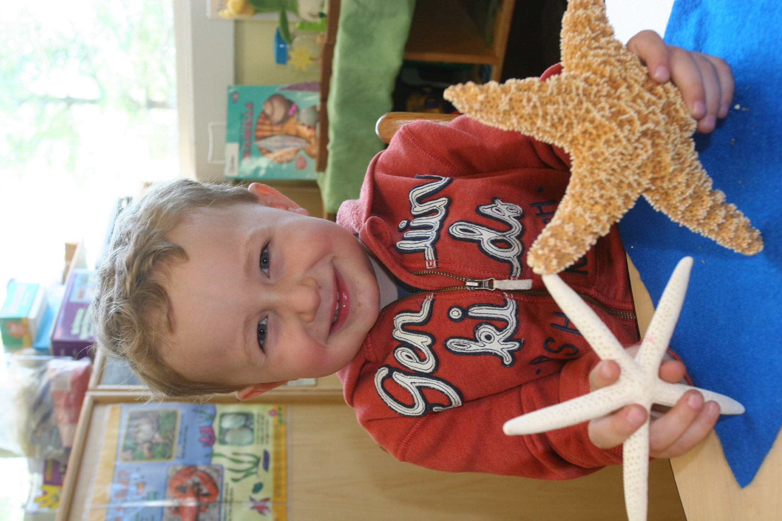
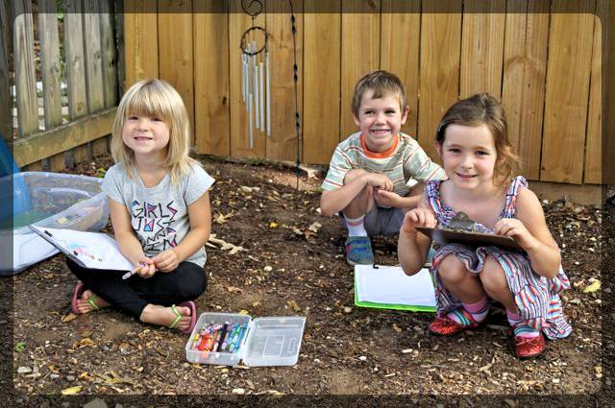
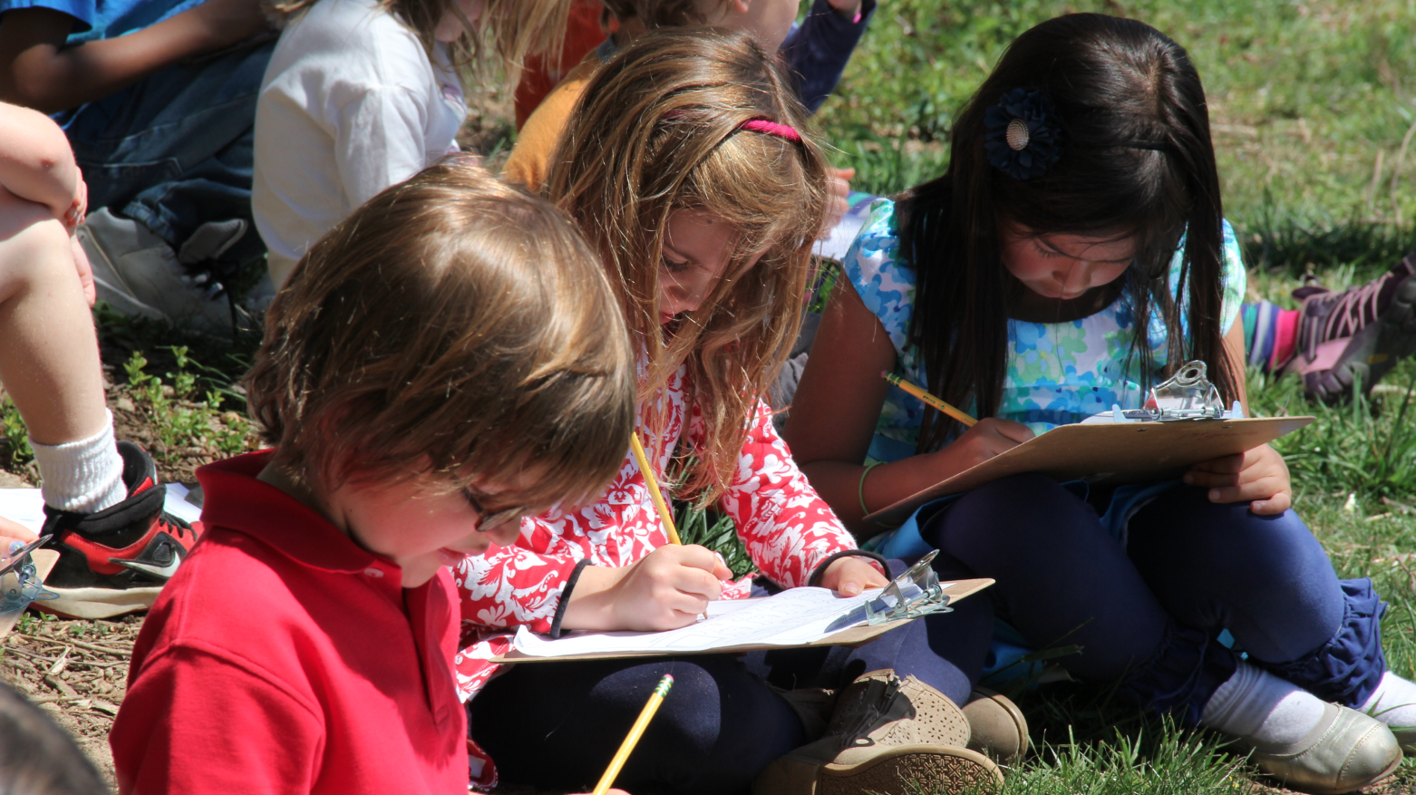
Curriculum Integration
  Each grade participates in a Citizen Science project.
  Nature Awareness field trips are led by our resident naturalist.
  Off site field trips and overnights encourage outdoor learning.
  Natural Domain Learning Goals are embedded in lesson plans and curriculum maps.

Slide 7
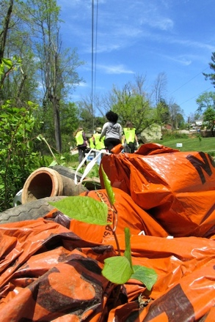
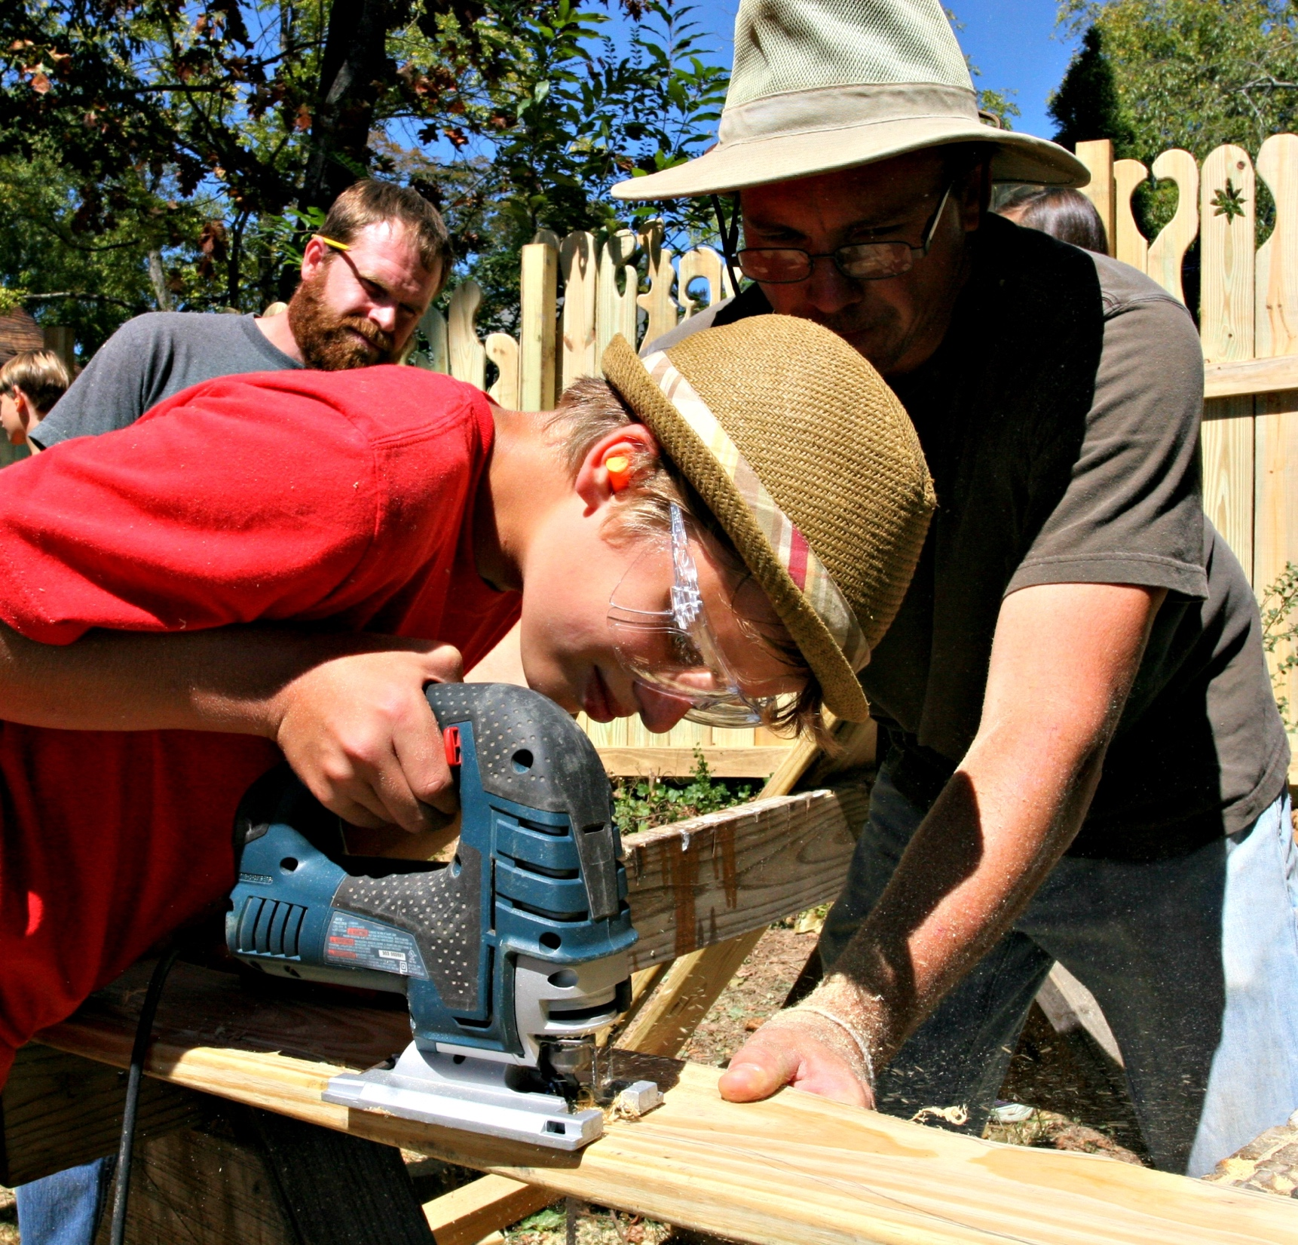
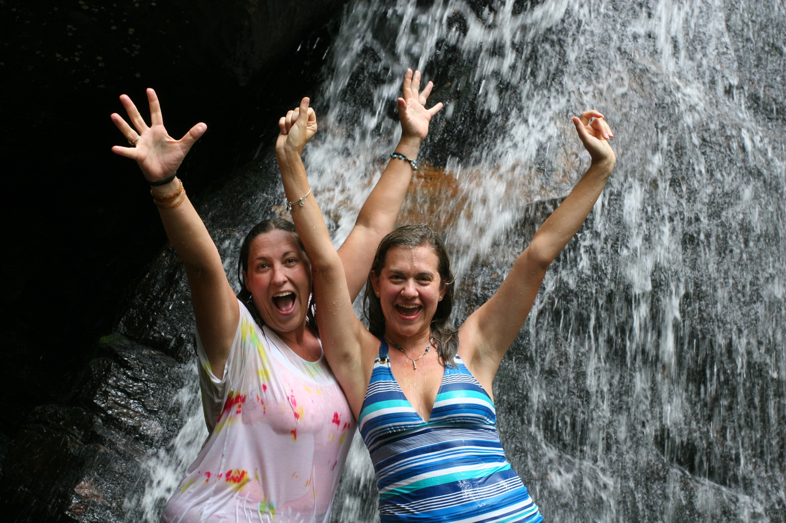
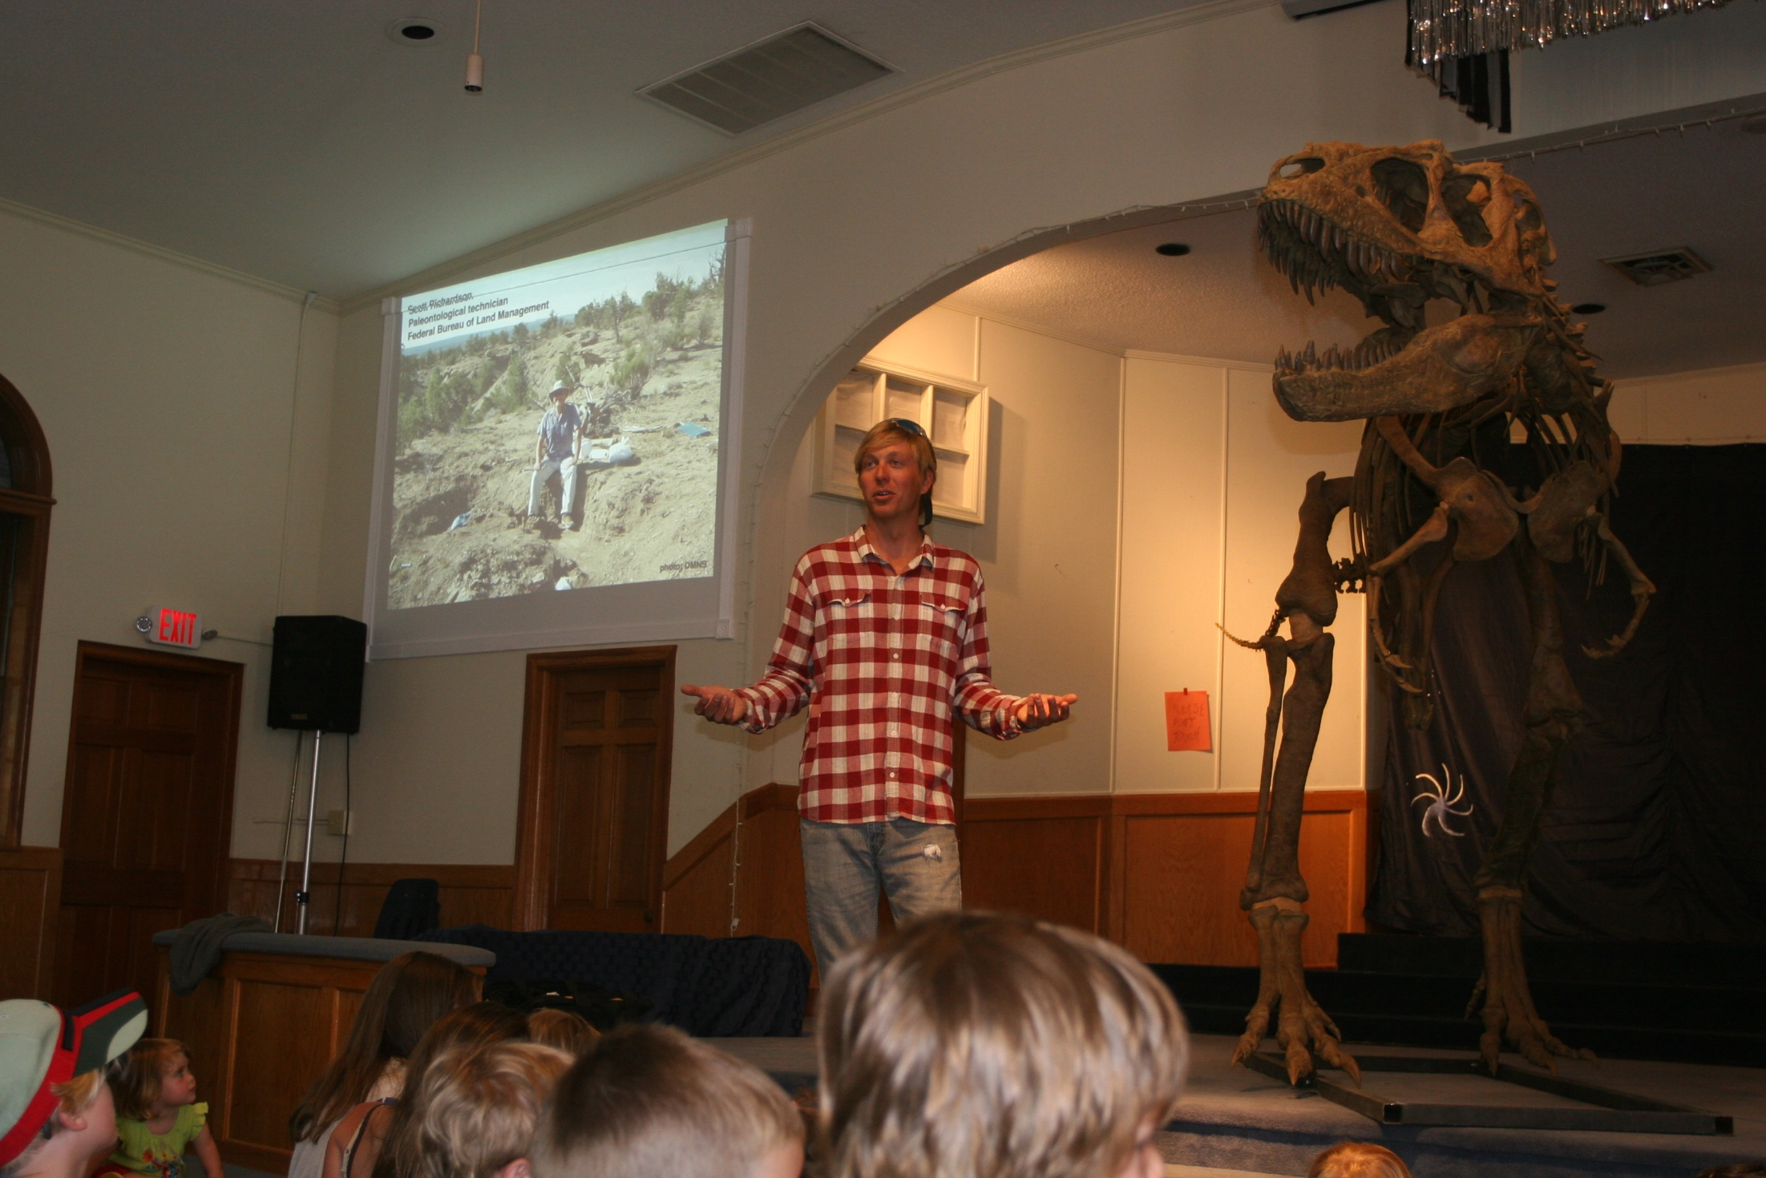
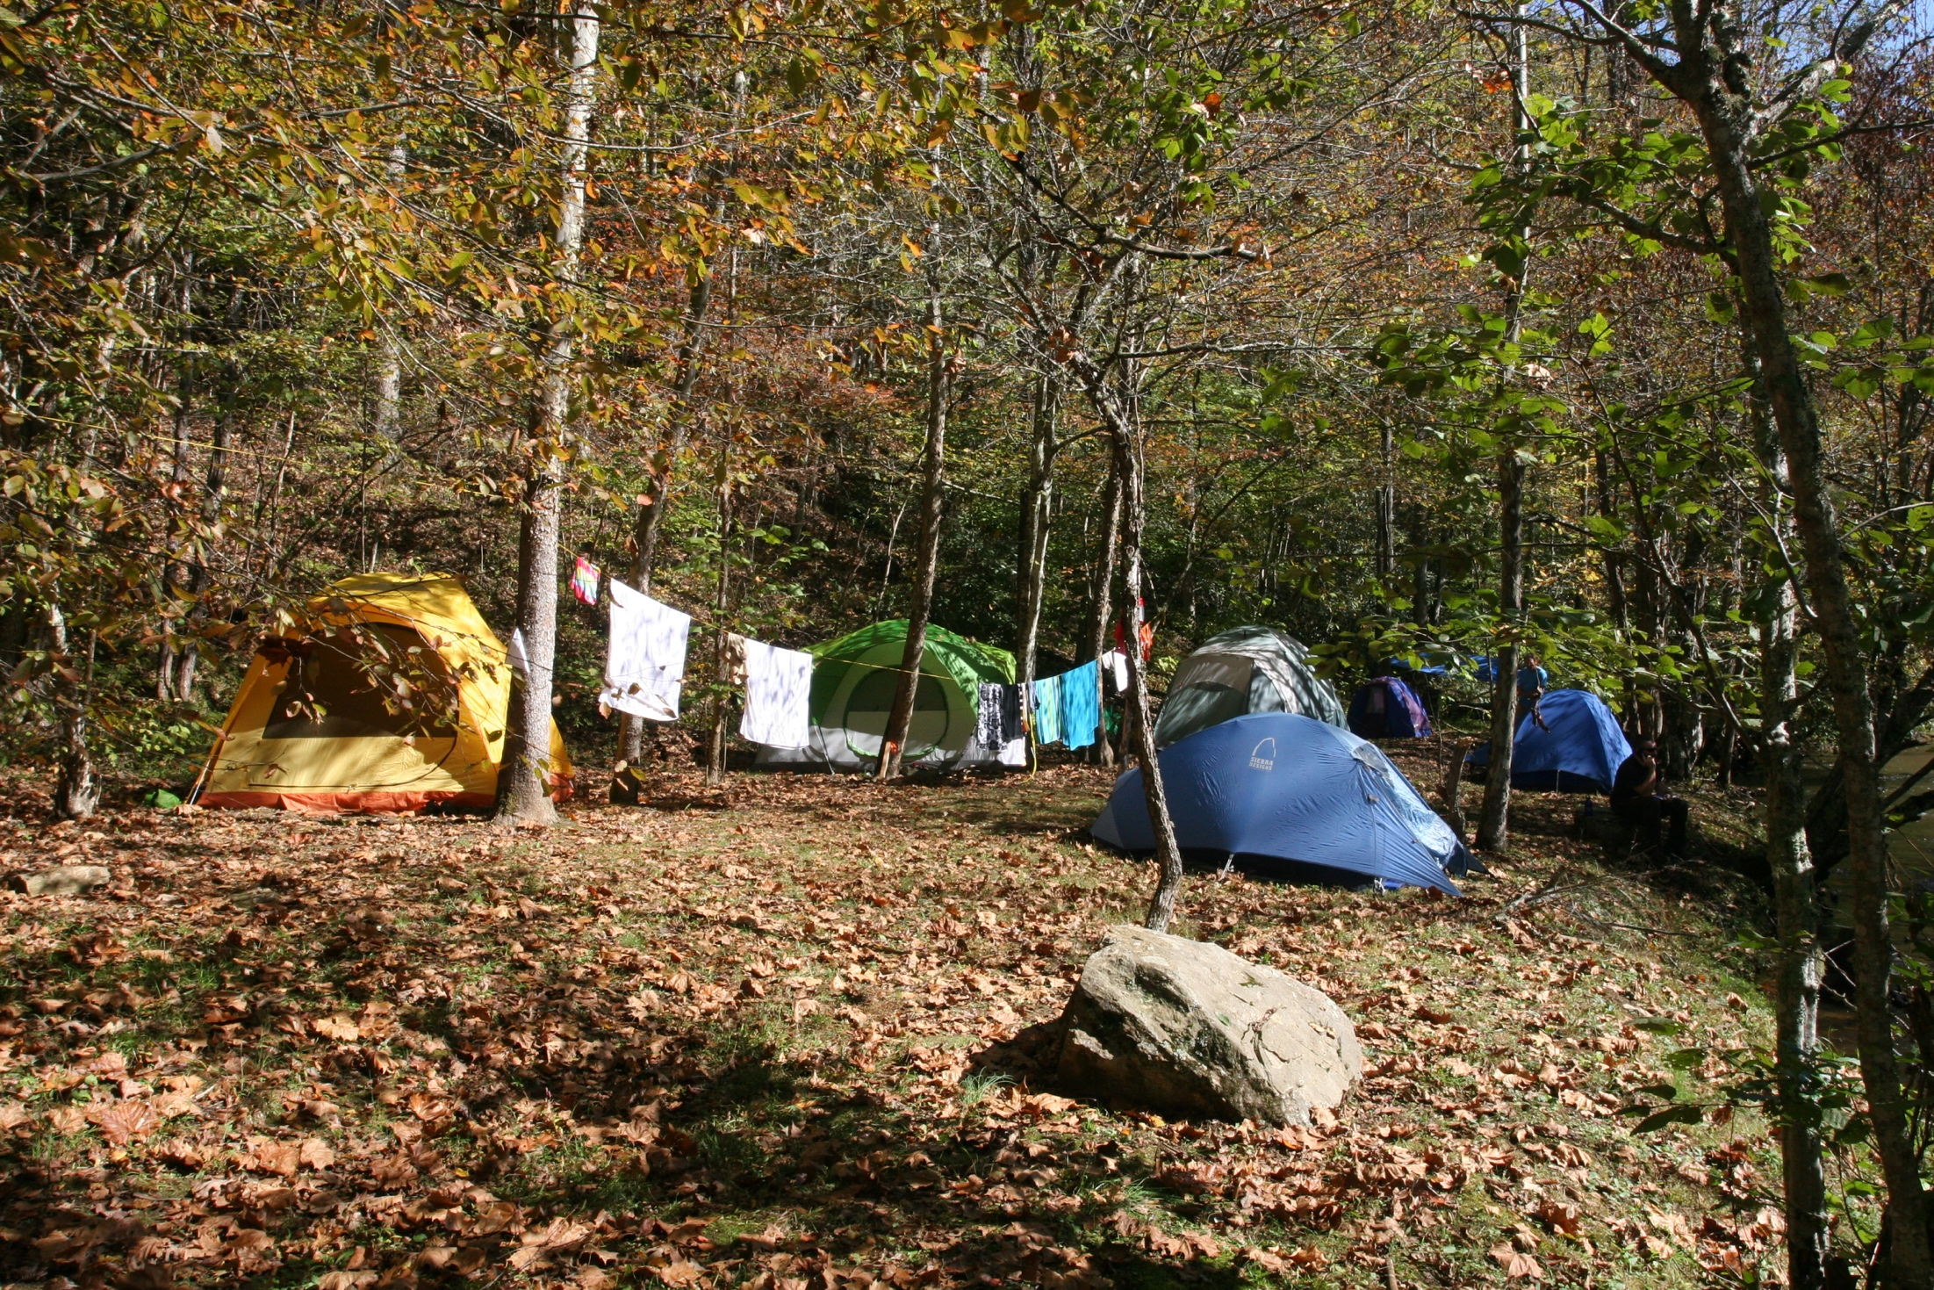
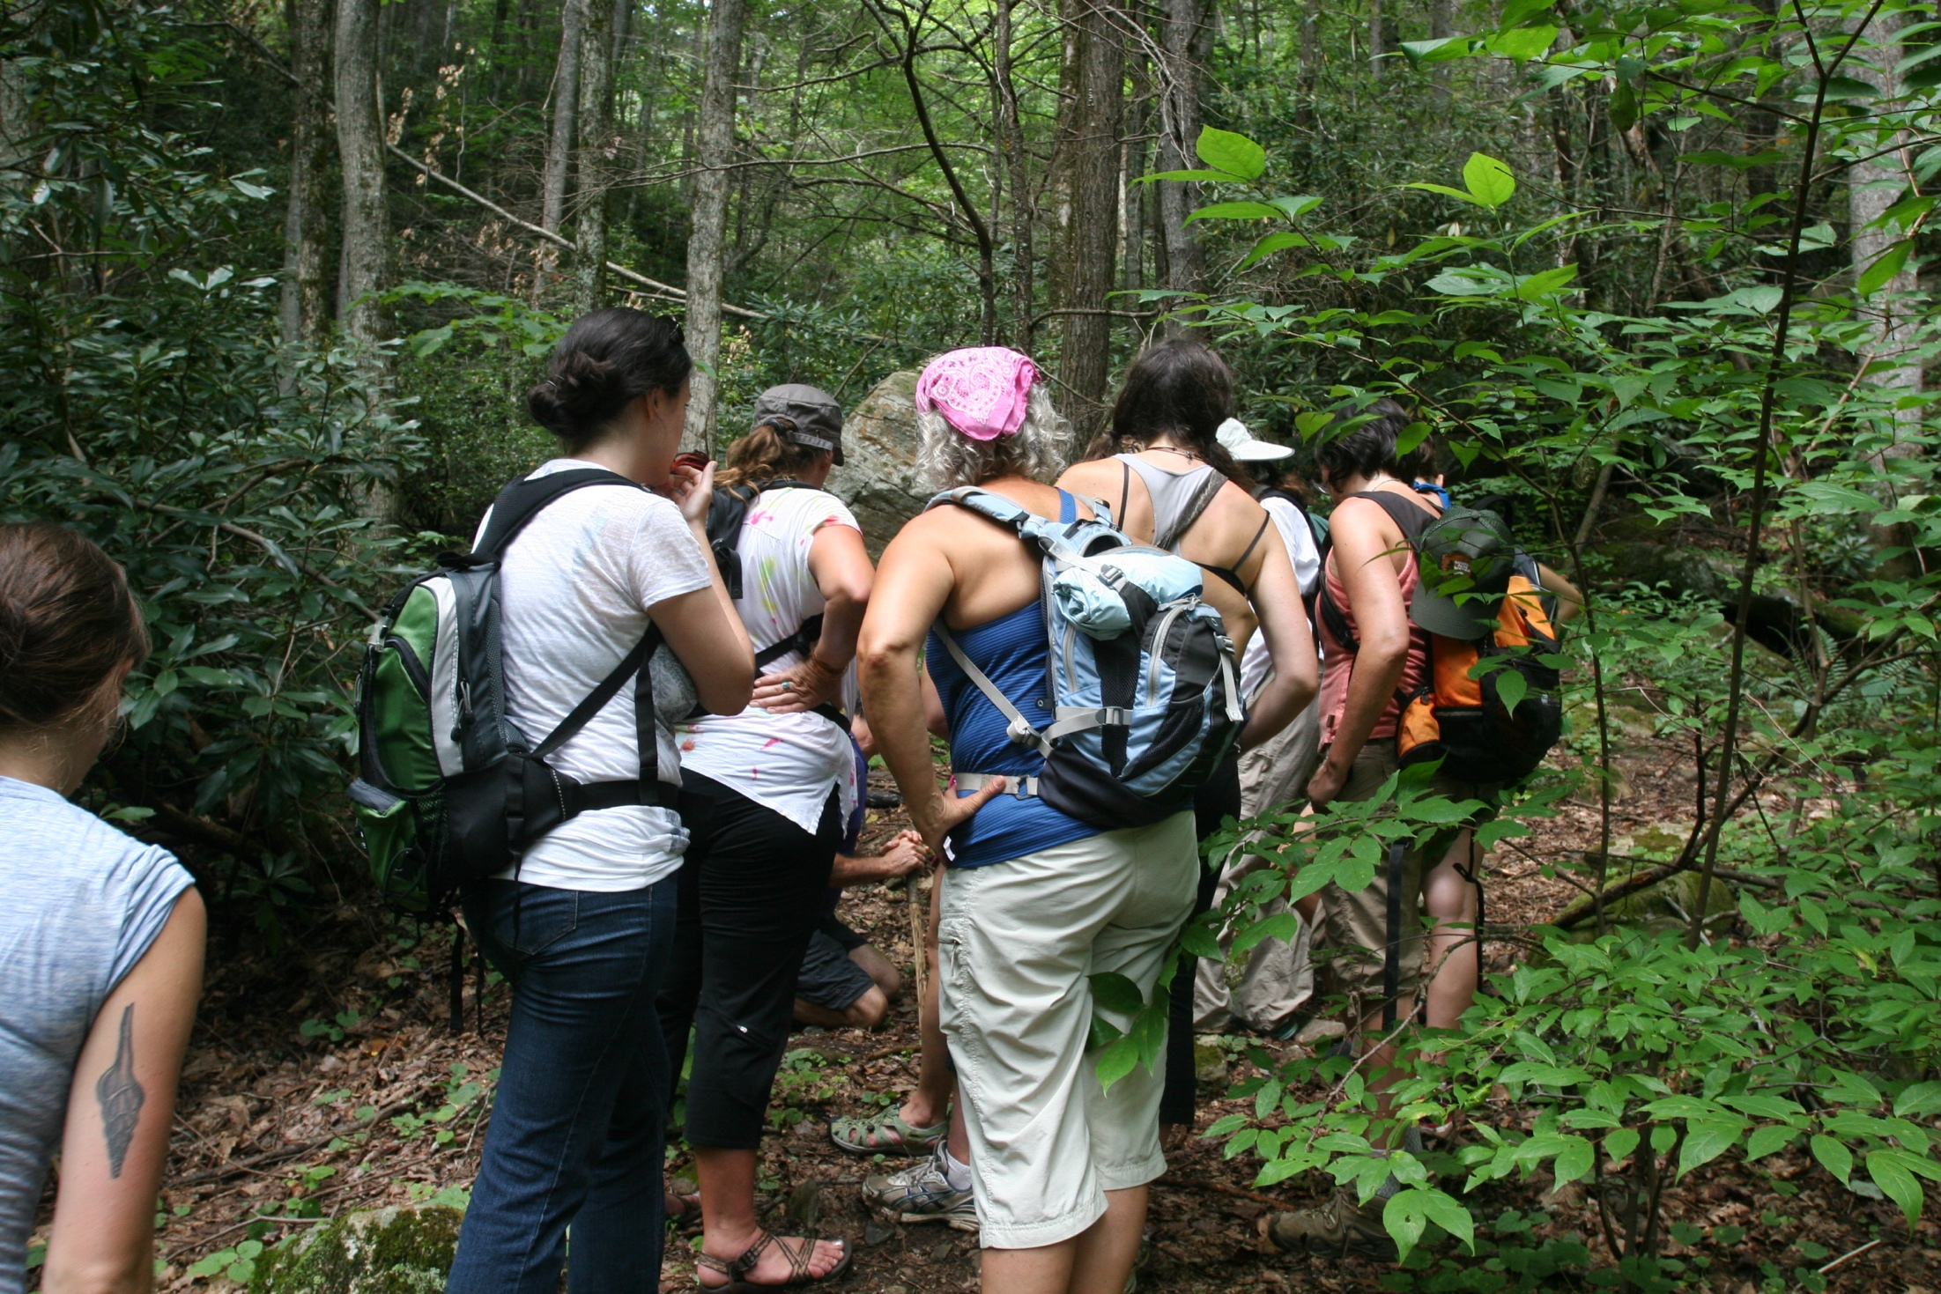
Curriculum Integration
  All students participate in Screen Free Week and Strive Not to Drive Week.
  All grades participate in campus and neighborhood beautification and community service.
  Each year the staff participates in a overnight retreat with goals of community building, risk taking while also strengthening relationships with the environment and the natural world.

Slide 8

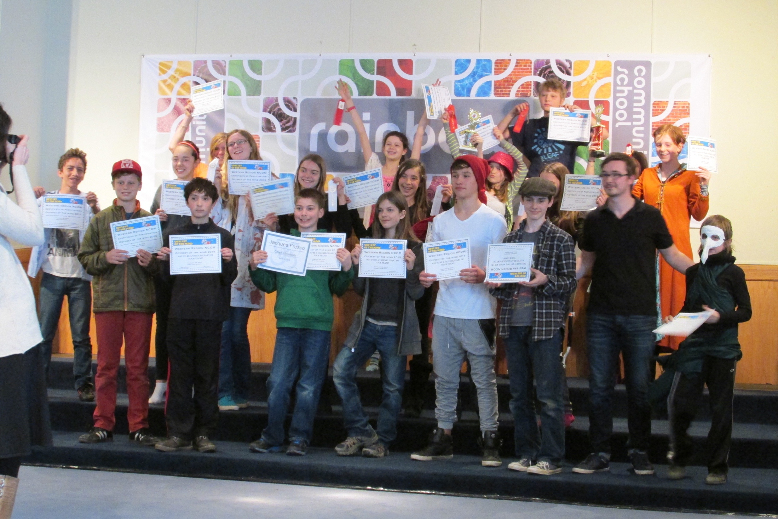
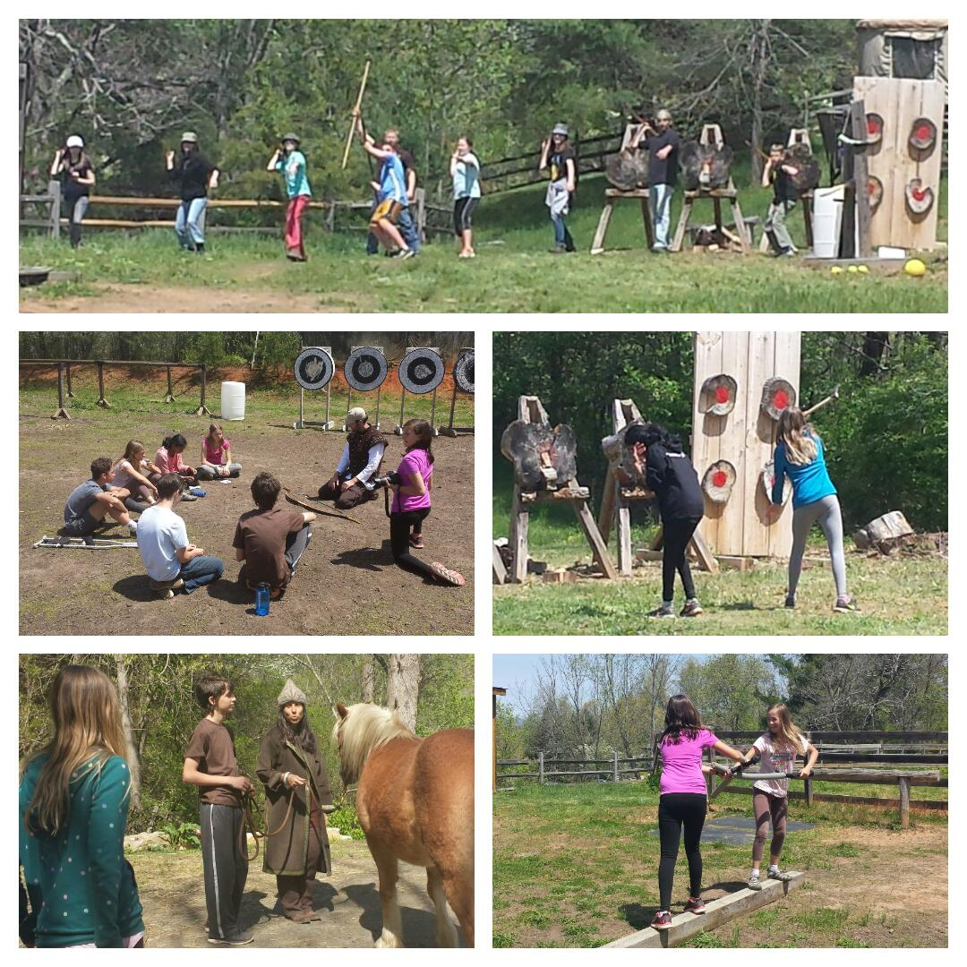
  RCS curriculum integrates tinkering and Maker Education, STEM, Design for Change and Social Entrepreneurship projects. We celebrate this learning through the Science and Innovation Fair.
  RCS has been awarded Best of WNC Science and Tech Education, 1st place in Solar Schools Challenge and is a Green Ribbon School.
  RCS participates and consistently places in the annual Odyssey of the Mind competition.
  The Omega Middle School program facilitates a connection to nature through electives such as Personal Mythology, Sacred Geometry, primitive skills, and outdoor adventure programming.

Slide 9
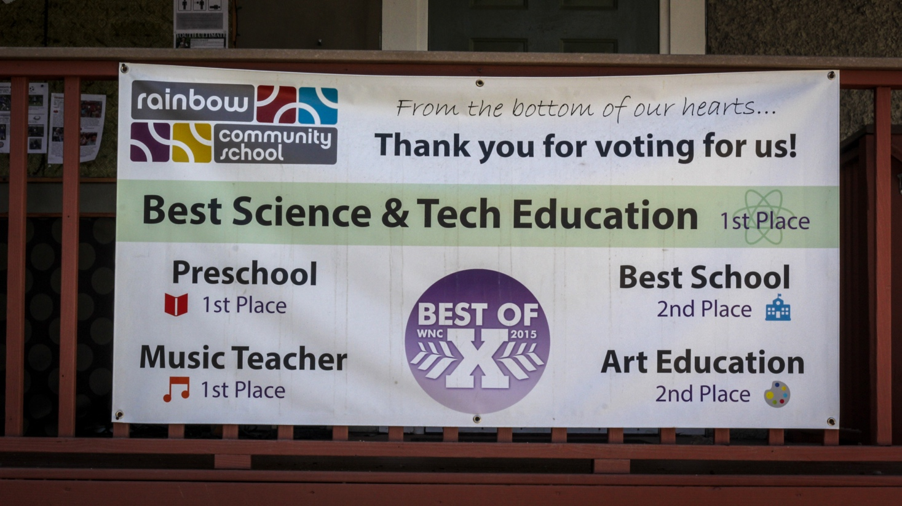
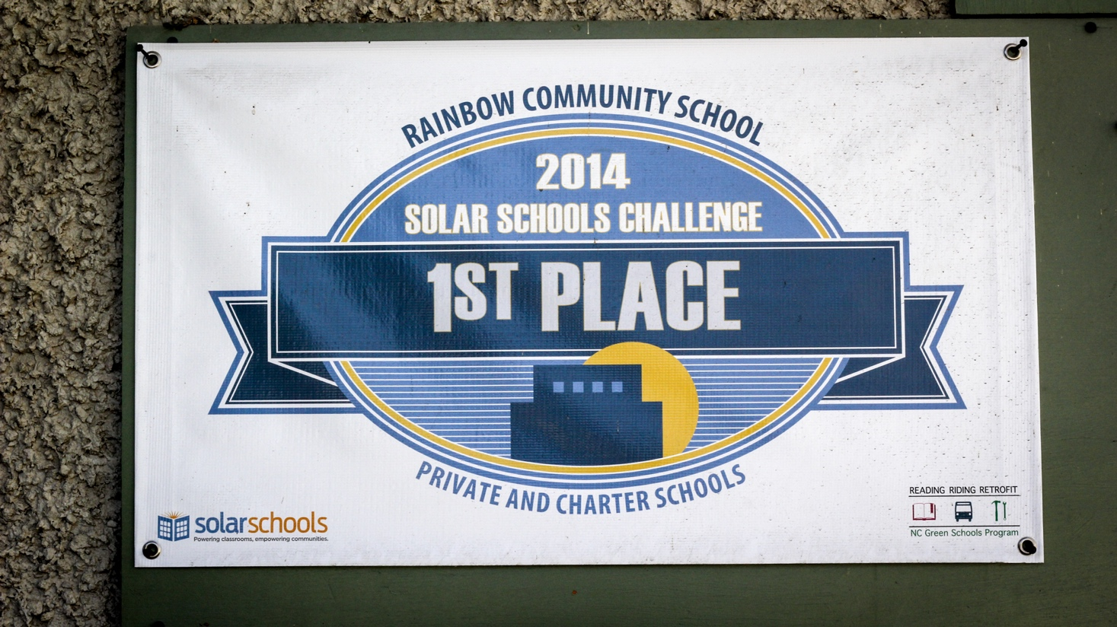
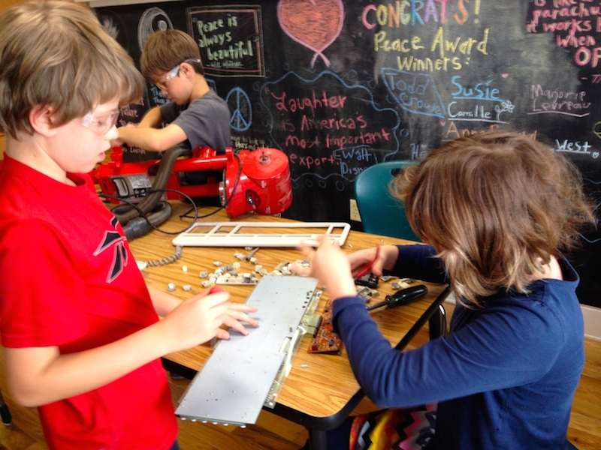

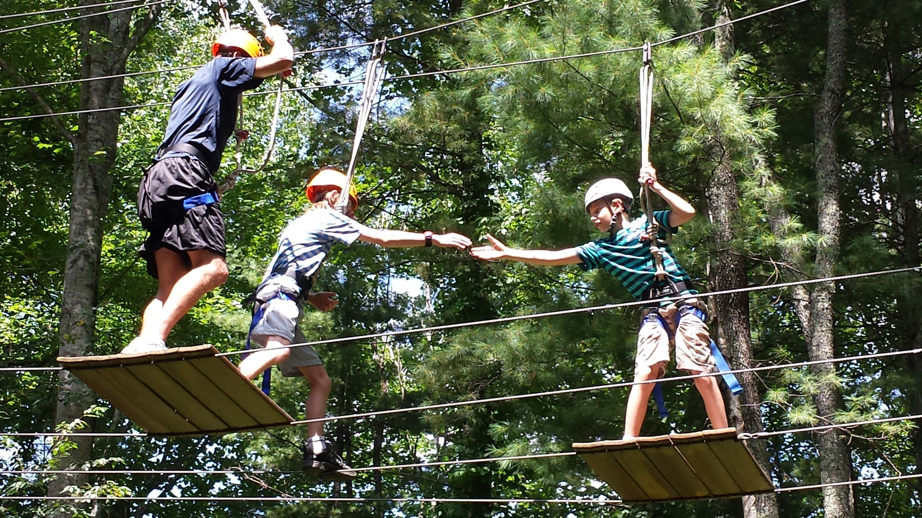
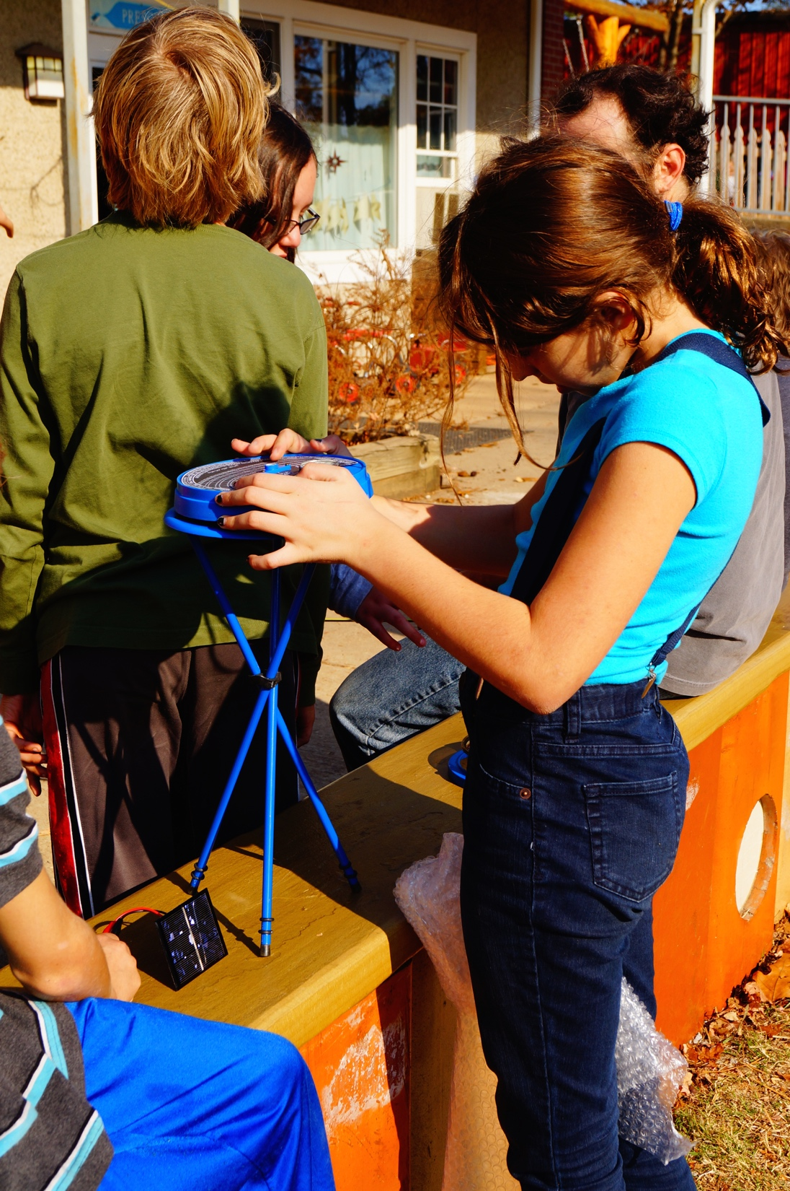
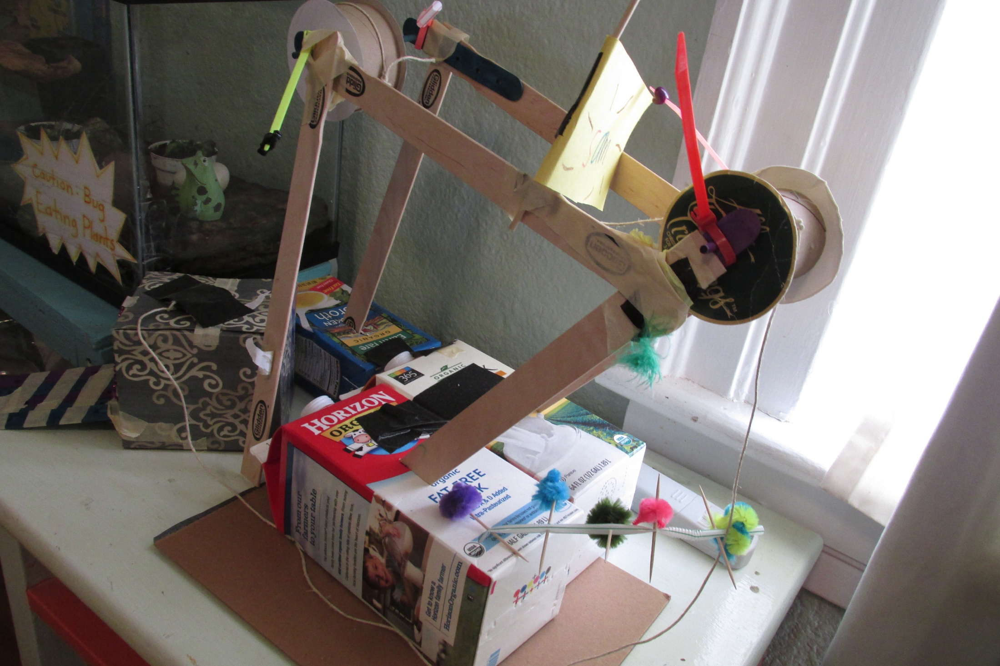
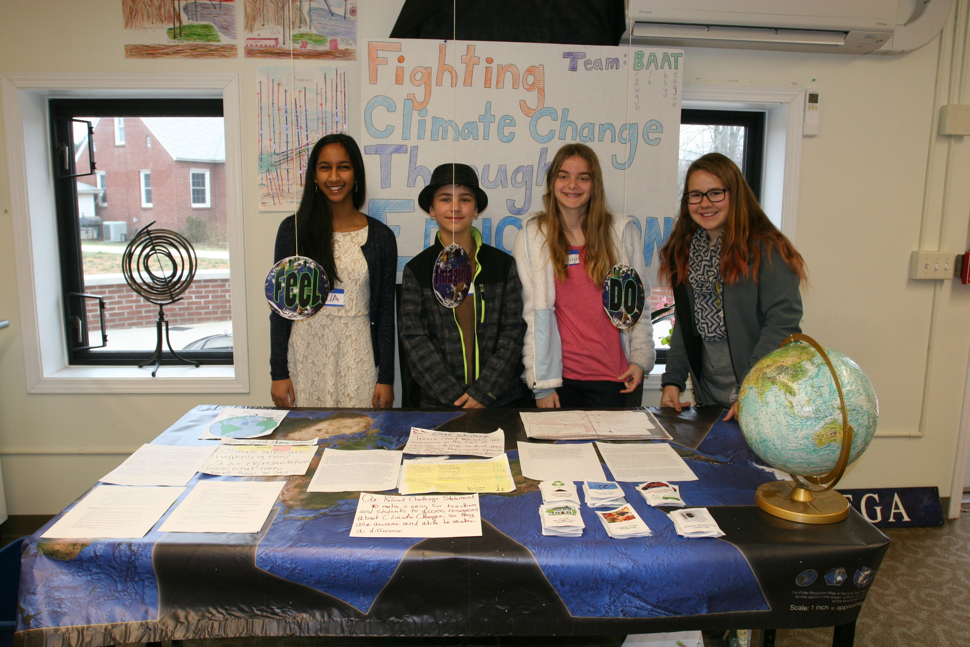
Tinkering and Maker Ed.
Adventure programming
Design for Change and Engineering
Science and Innovation Fair

